Slide 1
Evaluation and Visualization of Information Retrieval System

Slide 2
Performance Evaluation
Evaluation is a systematic determination of a subject’s merit, worth and significance, using criteria governed by a set of standards.
It ascertain the degree of achievement in regard to the aim and objectives and results of any such action that has been completed
Evaluation of information retrieval system measure which of the two existing system perform better and try to assess how the level of performance of a given can be improved.

Slide 3
Purpose of Evaluation
The main purpose of the evaluation is to focus on the process of implementation rather than on its impact.
Evaluation studies also investigate the degree to which the state goals have been achieved to which these can be achieved.
To measure information retrieval effectiveness in the standard way ,we need a test collection consisting of three things:
1. A document collection.
2. A test suite of information needs, expressible as queries
3. A set of relevance judgements, standardly a binary
assessment of either relevant or non relevant for each
query- document pair .

Slide 4
Performance Evaluation: Precision
Precision is the ratio of the relevant documents retrieved to the total number of documents retrieved.
Precision = Total number of documents retrieved that are relevant
Total number of documents that are retrieved.
It measures the accuracy of the retrieved documents.
High precision means that the system is returning a significant number of relevant results compared to irrelevant ones.

Slide 5
Performance Evaluation: Recall
Recall is the ratio of the relevant documents retrieved to the total number of relevant documents in the collection.
Recall = Total number of documents retrieved that are relevant
Total number of relevant documents in the database.
It measures the system's ability to retrieve all the relevant documents.
High recall means that the system is effectively retrieving a large portion of relevant results, even if it means some irrelevant documents are included.

Slide 6
Performance Evaluation: Precision &Recall (examples)
Precision: Imagine you are using a search engine to find information about cars, and you enter the query "luxury cars." The search engine returns ten results, and after examining them, you find that eight of them are indeed about luxury cars, while the other two are about budget cars. In this case, the precision of the search results is 8/10 or 80%. It means that 80% of the retrieved documents are relevant to your query.
Recall: Continuing from the previous example, let's assume that there are a total of 100 relevant documents in the search engine's database related to "luxury cars." Out of these 100 relevant documents, the search engine successfully retrieves 80 of them in response to your query "luxury cars." In this case, the recall of the search results is 80/100 or 80%. It means that the system managed to retrieve 80% of all the relevant documents in the database.

Slide 7
Performance Evaluation: Precision &Recall (continues..)
In summary, precision is the percentage of retrieved documents that are relevant to the query, while recall is the percentage of all relevant documents that were successfully retrieved by the system.
An ideal IR system aims to achieve high precision to provide accurate results and high recall to ensure it doesn't miss relevant documents.
However, striking the right balance between precision and recall depends on the specific needs of the users and the application of the IR system.

Slide 8
Mean Reciprocal Rank-MRR
Mean Reciprocal Rank (MRR) is a metric used in Information Retrieval (IR) systems to evaluate the performance of ranking algorithms. It measures the effectiveness of how well a system ranks relevant documents in response to user queries.
The reciprocal rank of a query response is the multiplicative inverse of the rank of the first correct answer:-1 for first place, ½ for second place, 1/3 for third place and so on.
MRR is calculated by taking the reciprocal of the rank of the first relevant document for each query and then averaging these reciprocal ranks across all queries.
The formula for calculating MRR is as follows:
MRR = (1 / N) * Σ(1 / rank_i)
where N is the total number of queries and rank_i is the rank of the first relevant document for the ith query.

Slide 9
Mean Reciprocal Rank-MRR (continues..)
The reciprocal value of the mean reciprocal rank corresponds to the harmonic mean of the ranks.
So ,the mean reciprocal rank is the average of the reciprocal ranks of results for a sample of queries.
A higher MRR value indicates better performance, as it means relevant documents are ranked higher on average across all queries.
MRR is often used in scenarios where multiple relevant documents might exist for a single query. It provides a single value that gives an indication of the quality of the ranking algorithm in returning relevant results higher in the list.

Slide 10
Mean Reciprocal Rank-MRR (example..)
Here's an example of how MRR is calculated:
Let's say we have a query "apple" and an IR system retrieves the following ranked list of documents along with their relevance scores:
Document A - Relevant
Document B - Irrelevant
Document C - Irrelevant
Document D - Relevant
Document E - Irrelevant
To calculate MRR, we find the reciprocal rank for each relevant document:
Reciprocal rank for Document A = 1/1 = 1.0
Reciprocal rank for Document D = 1/4 = 0.25
Then, we take the average of these reciprocal ranks:
MRR = (1.0 + 0.25) / 2 = 0.625
So, the MRR for this example is 0.625.

Slide 11
F-Score
In statistical analysis of binary classification, the F-score or F-measure is a measure of a test's accuracy.
F-score is a metric commonly used to evaluate the system's performance in terms of both precision and recall. It provides a single value that considers both metrics together.
Precision is also known as positive predictive value, and recall is also known as sensitivity in diagnostic binary classification.
The F₁ score is the harmonic mean of the precision and recall.

Slide 12
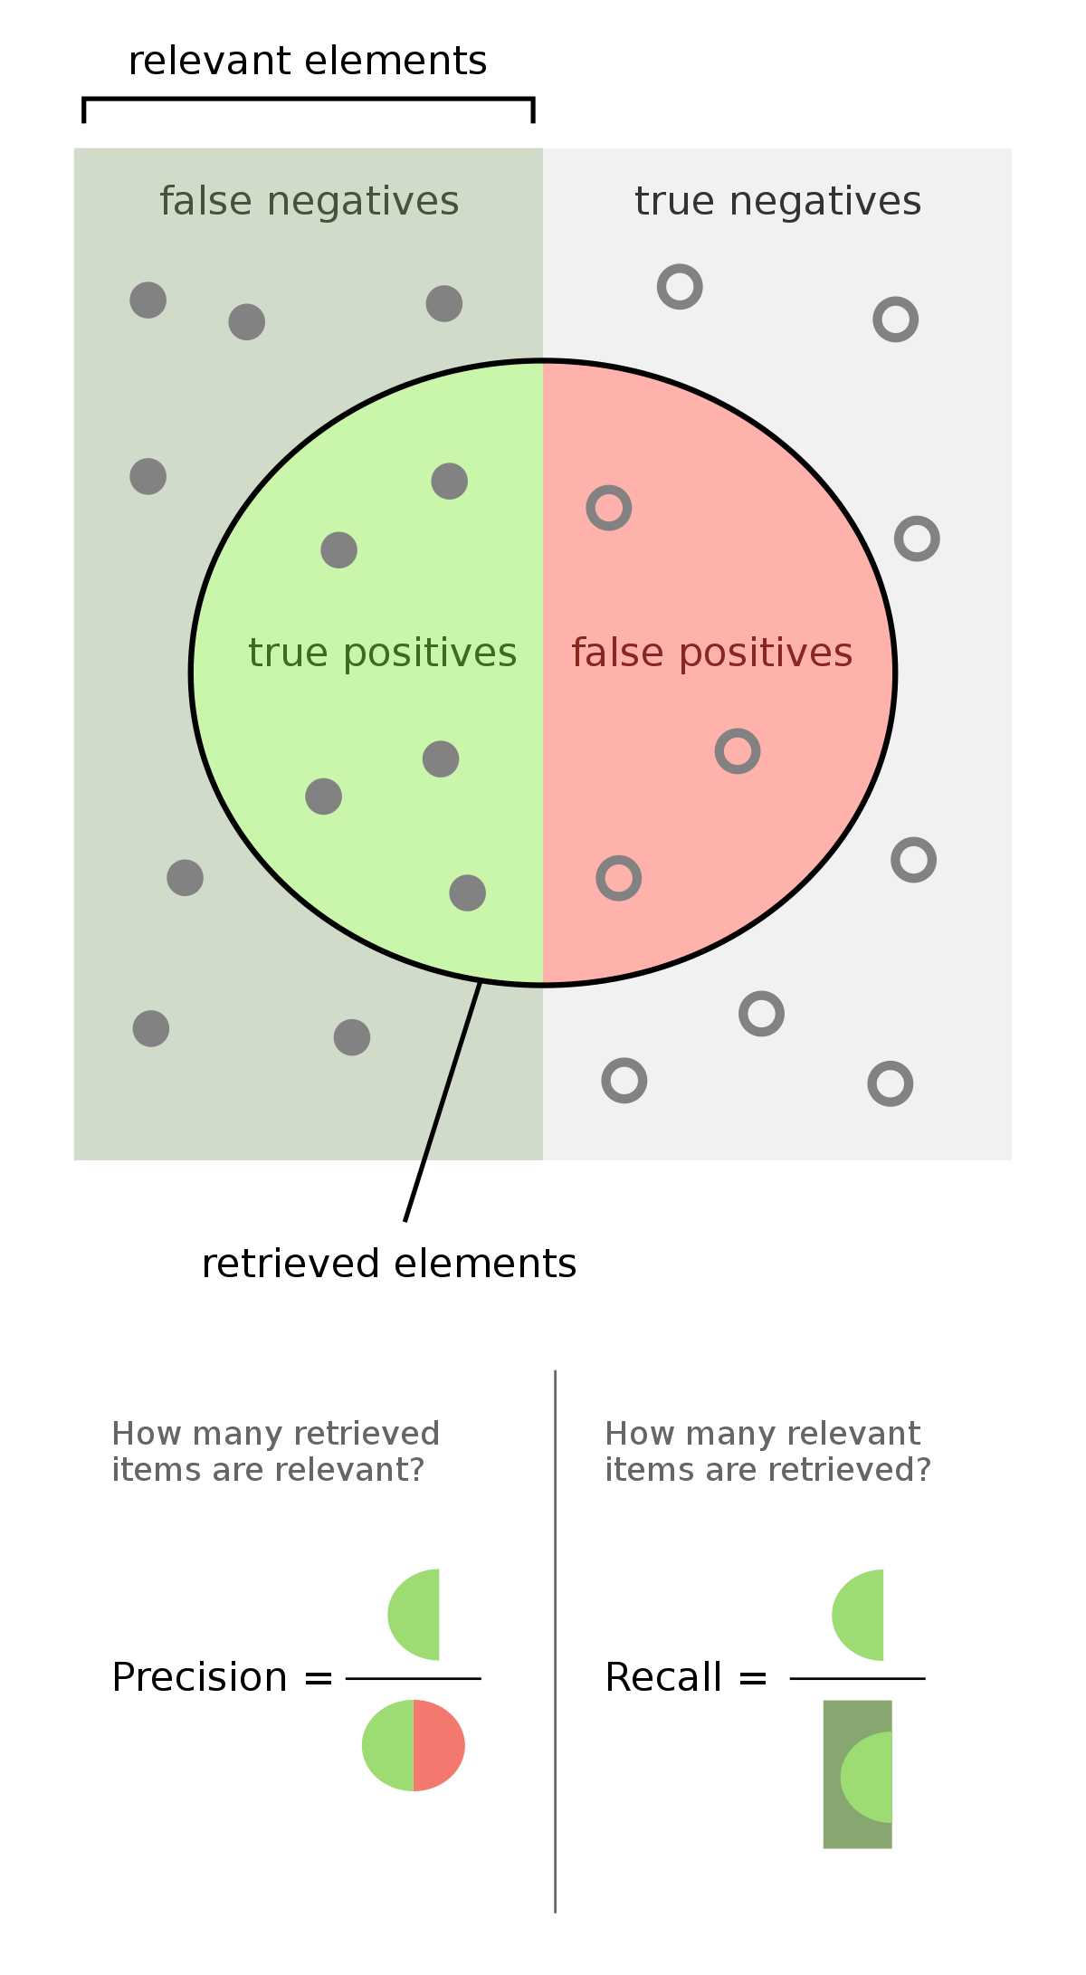
F-Score (continues..)
The F-score is calculated using the following formula:
F-score = 2 * (Precision * Recall)
(Precision + Recall)
where ,
precision is the number of true positive results divided by the number of all positive results, including those not identified correctly, and recall is the number of true positive results divided by the number of all samples that should have been identified as positive.
The highest possible value of an F-score is 1.0, indicating perfect precision and recall, and the lowest possible value is 0, if either precision or recall are zero.

Slide 13
F_{β} score
The Fβ score is a variant of the F1 score that allows you to balance precision and recall based on a parameter β. The F1 score is the harmonic mean of precision and recall, giving equal weight to both metrics. However, in some cases, you might want to give more importance to either precision or recall, depending on the specific needs of your problem.
The formula for the Fβ score is as follows:
Fβ = (1 + β²) * (precision * recall) / (β² * precision + recall)
Where:
Precision is the ratio of true positive predictions to the total number of positive predictions made by the model.
- Recall (sensitivity) is the ratio of true positive predictions to the total number of actual positive instances in the dataset.
- β is a parameter that determines the trade-off between precision and recall. When β > 1, more emphasis is placed on recall; when 0 < β < 1, more emphasis is placed on precision; and when β = 1, the Fβ score reduces to the F1 score.
In summary, the Fβ score allows you to customize the balance between precision and recall to suit your specific requirements.

Slide 14
Discounted Cumulative Gain(DCG)
DCG stands for "Discounted Cumulative Gain," and it is a commonly used metric in information retrieval (IR) systems to evaluate the quality of search results or ranking algorithms. DCG takes into account both the relevance and the rank position of documents retrieved in response to a user query.
Here's how DCG is calculated:
1. The DCG value for a ranked list of documents is calculated by summing up the relevance scores of the documents at each rank position, discounted by a logarithmic function of the rank position.
2. The relevance scores of the documents are usually assigned as binary values (e.g., 0 for non-relevant documents and 1 for relevant documents) or graded values (e.g., relevance scores from 0 to 3).
3. The discount factor in DCG penalizes documents appearing at lower ranks, giving higher importance to relevant documents that are ranked higher
4. The formula for DCG at rank k is given by:
DCG@k = rel_1 + ∑(rel_i / log2(i + 1)), where i ranges from 2 to k.
Here, rel_i represents the relevance score of the document at position i in the ranking.

Slide 15
Normalized Discounted Cumulative Gain(NDGC)
The term is "nDCG," which stands for "Normalized Discounted Cumulative Gain." As I explained in my previous response, nDCG is a normalization of DCG (Discounted Cumulative Gain) and is commonly used in information retrieval (IR) systems to evaluate the quality of search results or ranking algorithms.
DCG is used to compare the performance of different retrieval models or configurations objectively. It ranges from 0 to 1, where 1 represents the perfect ranking order of documents, and lower values indicate suboptimal rankings.
To calculate nDCG:
Calculate the DCG for the ranked list of documents at a specific rank cutoff (e.g., nDCG@k).
Calculate the ideal DCG for the same set of relevance scores but with documents sorted in descending order of their relevance scores.
Divide the DCG by the ideal DCG to get the normalized value.
The formula for nDCG at rank k is given by:
nDCG@k = DCG@k / IDCG@k
Where:
DCG@k is the Discounted Cumulative Gain at rank k.
IDCG@k is the Ideal Discounted Cumulative Gain at rank k (obtained from the perfect ranking).

Slide 16
Visualization in Information System: Starting points
Search interfaces must provide users with good ways to get started. An empty screen or a blank entry form does not provide clues to help a user decide how to start the search process. Users usually do not begin by creating a long, detailed expression of their information need.
Studies show that users tend to start out with very short queries, inspect the results, and then modify those queries in an incremental feedback cycle .
The initial query can be seen as a kind of `testing the water' to see what kinds of results are returned and get an idea of how to reformulate the query . Thus, one task of an information access interface is to help users select the sources and collections to search on.
For example, there are many different information sources associated with cancer, and there are many different kinds of information a user might like to know about cancer. Guiding the user to the right set of starting points can help with the initial problem formulation.
In this section we will discuss four main types of starting points: lists, overviews, examples, and automated source selection.

Slide 17
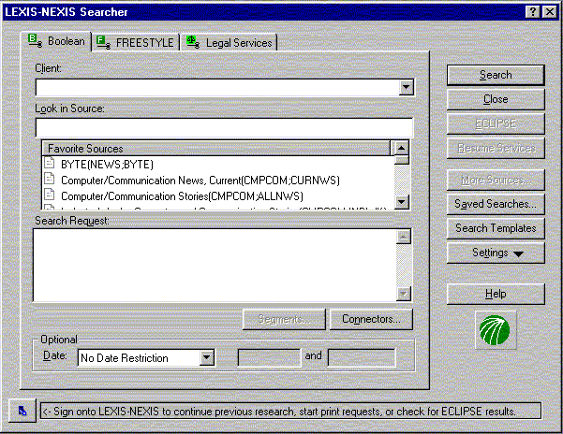
Starting Points:- List of Collections
Typical online systems such as LEXIS-NEXIS require users to begin any inquiry with a scan through a long list of source names and guess which ones will be of interest.
Usually little information beyond the name of the collection is provided online for these sources.
If the user is not satisfied with the results on one collection, they must reissue the query on another collection.

Slide 18
Starting points:-Overview
Faced with a large set of text collections, how can a user choose which to begin with? One approach is to study an overview of the contents of the collections.
An overview can show the topic domains represented within the collections, to help users select or eliminate sources from consideration. An overview can help users get started, directing them into general neighborhoods, after which they can navigate using more detailed descriptions.
An interaction model in which the user begins with an overview of the information to be worked with, then pans and zooms to find areas of potential interest, and then view details. The process is repeated as often as necessary.
Three types of overviews are discussed in this subsection. The first is display and navigation of large topical category hierarchies associated with the documents of a collection.
The second is automatically derived overviews, usually created by unsupervised clustering techniques on the text of documents, that attempt to extract overall characterizing themes from collections.
The third type of overview is that created by applying a variant of co-citation analysis on connections or links between different entities within a collection.

Slide 19
Starting points:- Category or Directory Overviews
The meanings of category labels differ somewhat among collections. Most are designed to help organize the documents and to aid in query specification.
Most interfaces that depict category hierarchies graphically do so by associating a document directly with the node of the category hierarchy to which it has been assigned.
For example, clicking on a category link in Yahoo! brings up a list of documents that have been assigned that category label. Conceptually, the document is stored within the category label.
When navigating the results of a search in Yahoo!, the user must look through a list of category labels and guess which one is most likely to contain references to the topic of interest.
A wrong path requires backing up and trying again, and remembering which pages contain which information.
If the desired information is deep in the hierarchy, or not available at all, this can be a time-consuming and frustrating process. Because documents are conceptually stored `inside' categories, users cannot create queries based on combinations of categories using this interface.
It is difficult to design a good interface to integrate category selection into query
specification, in part because display of category hierarchies takes up large
amounts of screen space

Slide 20
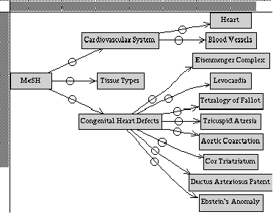
(continues…)
Figure: The MeSHBrowse interface for viewing category labels hierarchically .

Slide 21
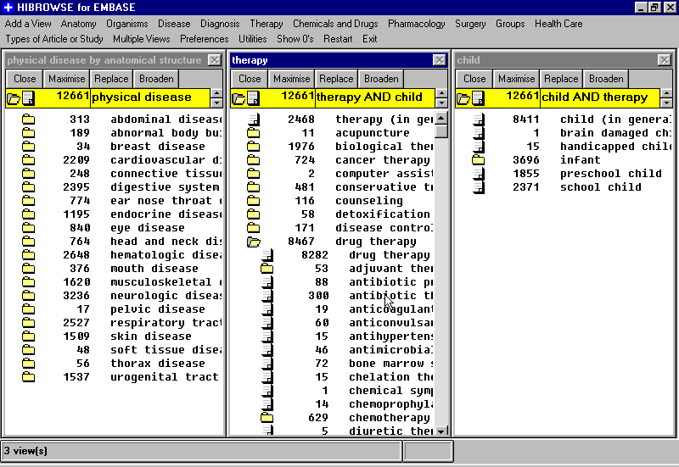
(continues…)
Figure: The HiBrowse interface for viewing category labels hierarchically and according to facets .

Slide 22
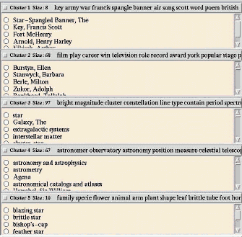
Starting points:- AutomaticallyDerived Collection Overviews
Many attempts to display overview information have focused on automatically extracting the most common general themes that occur within the collection. These themes are derived via the use of unsupervised analysis methods, usually variants of document clustering.
Clustering organizes documents into groups based on similarity to one another; the centroids of the clusters determine the themes in the collections.
The Scatter/Gather browsing paradigm clusters documents into topically-coherent groups, and presents descriptive textual summaries to the user

Slide 23
Query Specification
To formulate a query, a user must select collections, metadata descriptions, or information sets against which the query is to be matched, and must specify words, phrases, descriptors, or other kinds of information that can be compared to or matched against the information in the collections.
As a result, the system creates a set of documents, metadata, or other information type that match the query specification in some sense and displays the results to the user in some form

Slide 24
Boolean Queries
Boolean queries are problematic for several reasons. Foremost among these is that most people find the basic syntax counter-intuitive. Many English-speaking users assume everyday semantics are associated with Boolean operators when expressed using the English words AND and OR, rather than their logical equivalents. To inexperienced users, using AND implies the widening of the scope of the query, because more kinds of information are being requested. For instance, `dogs and cats' may imply a request for documents about dogs and documents about cats, rather than documents about both topics at once. `Tea or coffee' can imply a mutually exclusive choice in everyday language.

Slide 25
From Command Lines to Form and Menus.
Boolean query specification in online bibliographic systems is the
arbitrariness of the syntax and the contextlessness nature of the TTY-based interface
in which they are predominantly available. Typically input is typed at a prompt and
is of a form something like the following:
COMMAND ATTRIBUTE value {BOOLEAN-OPERATOR ATTRIBUTE value}* e.g., FIND PA darwin AND TW species OR TW descent or FIND TW Mt St. Helens AND DATE 1981
The user must remember the commands and attribute names, which are easily forgotten
between usages of the system . Compounding this problem, despite the fact that
4 the command languages for the two main online bibliographic systems at UC Berkeley have
different but very similar syntaxes, after more than ten years one of the systems still reports an
error if the author field is specified as PA instead of PN, as is done in the other system.
This lack of flexibility in the syntax is characteristic of interfaces designed to suit the system
rather than its users.
Bit-mapped displays are an improvement over command-line interface, but do not solve
all the problems. For example, a blank entry form is in some ways not much better than a TTY
prompt, because it does not provide the user with clues about what kinds of terms should be entered.

Slide 26
Faceted Queries
Yet another problem with Boolean queries is that their strict interpretation tends to yield result sets that are either too large, because the user includes many terms in a disjunct, or are empty, because the user conjoins terms in an effort to reduce the result set. This problem occurs in large part because the user does not know the contents of the collection or the role of terms within the collection.
A common strategy for dealing with this problem, employed in systems with command-line-based interfaces like DIALOG's, is to create a series of short queries, view the number of documents returned for each, and combine those queries that produce a reasonable number of results. For example, in DIALOG, each query produces a resulting set of documents that is assigned an identifying name. Rather than returning a list of titles themselves, DIALOG shows the set number with a listing of the number of matched documents. Titles can be shown by specifying the set number and issuing a command to show the titles. Document sets that are not empty can be referred to by a set name and combined with AND operations to produce new sets. If this set in turn is too small, the user can back up and try a different combination of sets, and this process is repeated in pursuit of producing a reasonably sized document set.
This kind of query formulation is often called a faceted query, to indicate that the user's query is divided into topics or facets, each of which should be present in the retrieved documents

Slide 27
Graphical approaches to query specification
Direct manipulation interfaces provide an alternative to command-line syntax. The properties of direct manipulation are (1) continuous representation of the object of interest, (2) physical actions or button presses instead of complex syntax, and (3) rapid incremental reversible operations whose impact on the object of interest is immediately visible. Direct manipulation interfaces often evoke enthusiasm from users, and for this reason alone it is worth exploring their use. Although they are not without drawbacks, they are easier to use than other methods for many users in many contexts.
Several variations of graphical interfaces, both directly manipulable and static, have been developed for simplifying the specification of Boolean syntax. User studies tend to reveal that these graphical interfaces are more effective in terms of accuracy and speed than command-language counterparts. Three such approaches are described below.

Slide 28
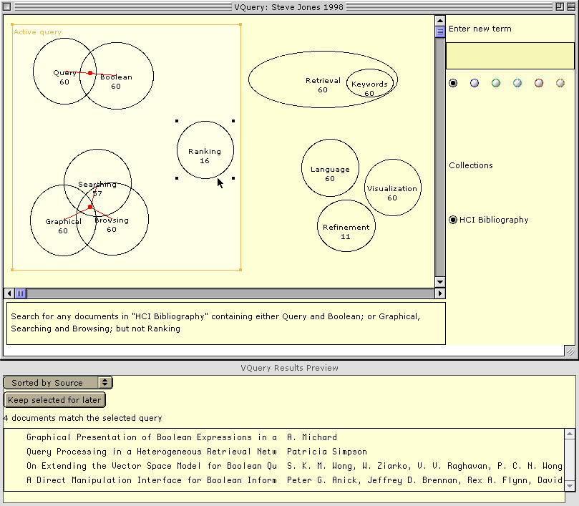

Slide 29
Phrases and Proximity
In general, proximity information can be quite effective at improving precision of searches. On the Web, the difference between a single-word query and a two-word exact phrase match can mean the difference between an unmanageable mess of retrieved documents and a short list with mainly relevant documents.
A large number of methods for specifying phrases have been developed. The syntax in LEXIS-NEXISrequires the proximity range to be specified with an infix operator. For example, `white w/3 house' means `white within 3 words of house, independent of order.’
Exact proximity of phrases is specified by simply listing one word beside the other, separated by a space. A popular method used by Web search engines is the enclosure of the terms between quotation marks.. This is suggested as a way to guide users to more precise query specification.
The disadvantage of these methods is that they require exact match of phrases, when it is often the case (in English) that one or a few words comes between the terms of interest. For example, in most cases the user probably wants `president' and `lincoln' to be adjacent, but still wants to catch cases of the sort `President Abraham Lincoln.' Another consideration is whether or not stemming is performed on the terms included in the phrase. The best solution may be to allow users to specify exact phrases but treat them as small proximity ranges, with perhaps an exponential fall-off in weight in terms of distance of the terms. This has been shown to be a successful strategy in non-interactive ranking algorithms

Slide 30
Natural Language and Free text processing
Statistical ranking algorithms have the advantage of allowing users to specify queries naturally, without having to think about Boolean or other operators. But they have the drawback of giving the user less feedback about and control over the results. Usually the result of a statistical ranking is the listing of documents and the association of a score, probability, or percentage beside the title. Users are given little feedback about why the document received the ranking it did and what the roles of the query terms are. This can be especially problematic if the user is particularly interested in one of the query terms being present.
One search strategy that can help with this particular problem with statistical ranking algorithms is the specification of `mandatory' terms within the natural language query. This in effect helps the user control which terms are considered important, rather than relying on the ranking algorithm to correctly weight the query terms. But knowing to include a mandatory specification requires the user to know about a particular command and how it works.
The preceding discussion assumes that a natural language query entered by the user is treated as a bag of words, with stopwords removed, for the purposes of document match. However, some systems attempt to parse natural language queries in order to extract concepts to match against concepts in the text collection

